Slide 1
State Purchasing Division
Leena Patel
IT Business Analyst III
State Purchasing Division

Slide 2
Today’s Agenda
Georgia Virtual Catalog New UX Changes
Georgia Virtual Catalog new search functionality
Google Chrome and Microsoft Edge – You are not authorized error

Slide 3
Jaggaer New UX Changes
Team Georgia Marketplace

Slide 4
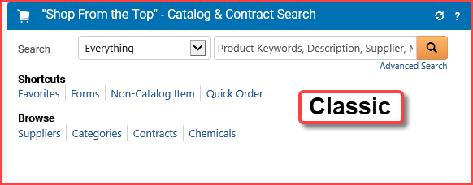
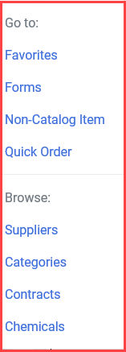
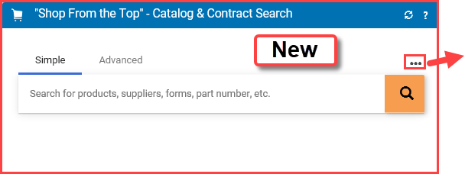
Classic Vs. New Shopping Home page

Slide 5
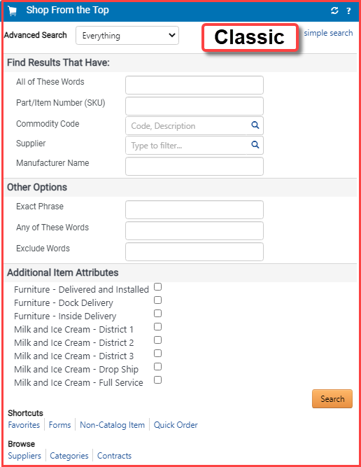
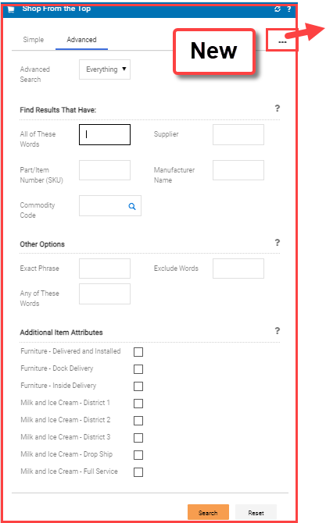
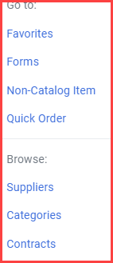
Classic Vs. New Advance Search

Slide 6
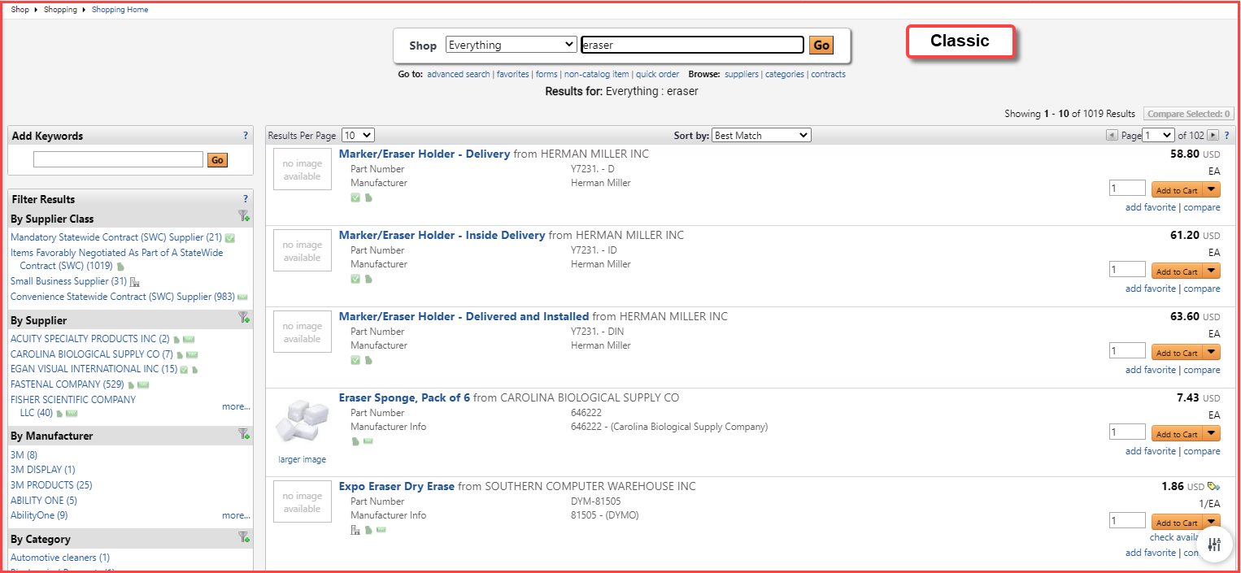
Classic Vs. New Search result

Slide 7
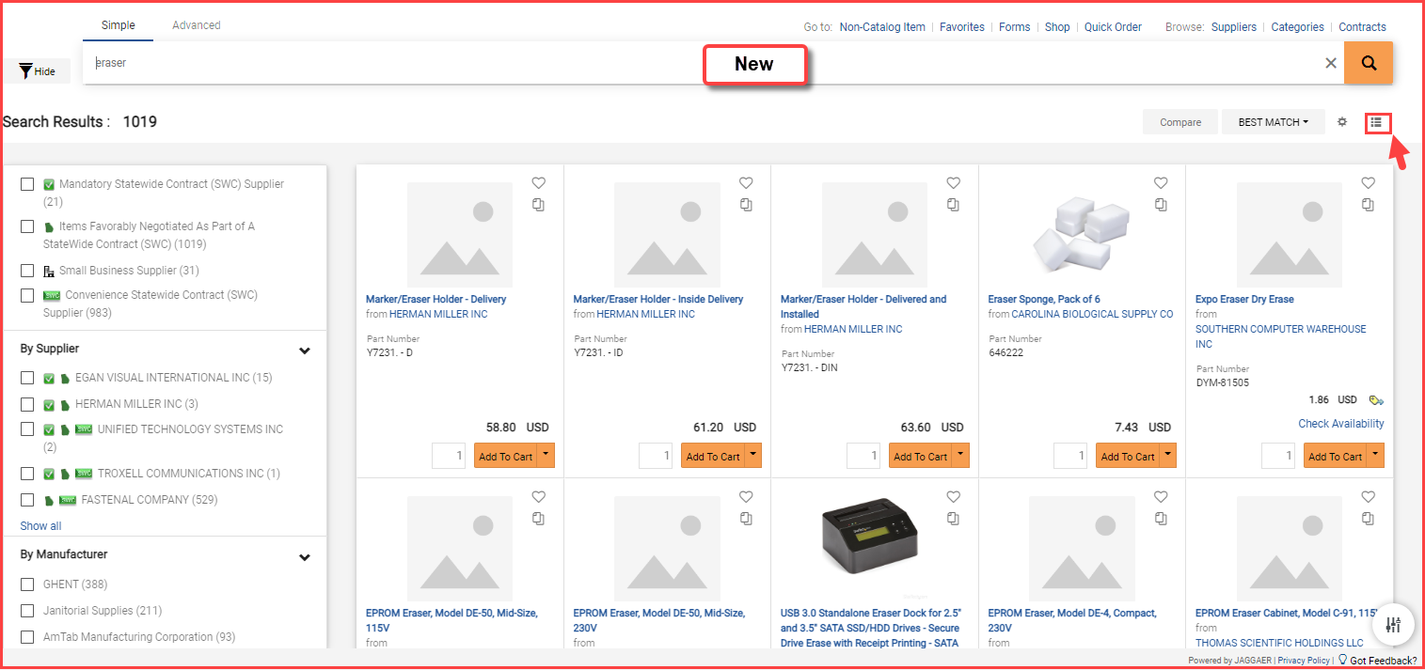
Classic Vs. New Search result

Slide 8
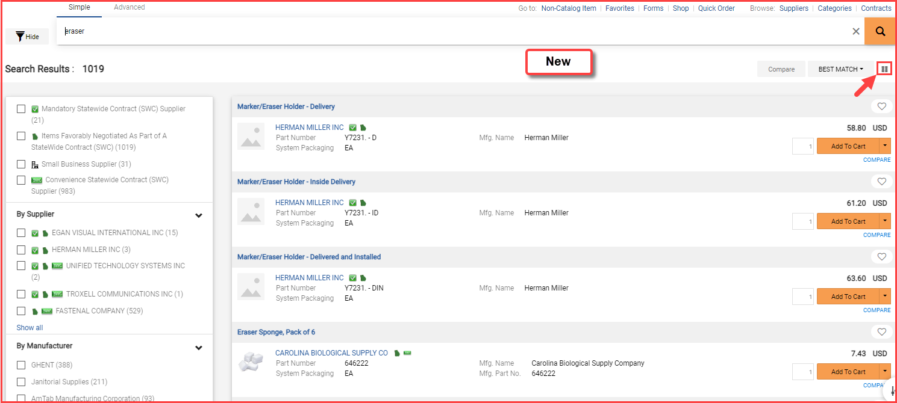
Classic Vs. New Search result

Slide 9
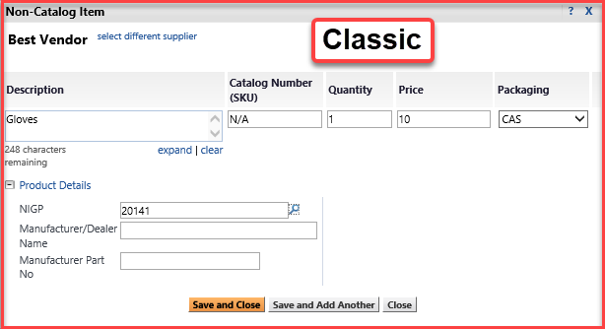
Classic Vs. New Non-Catalog item

Slide 10
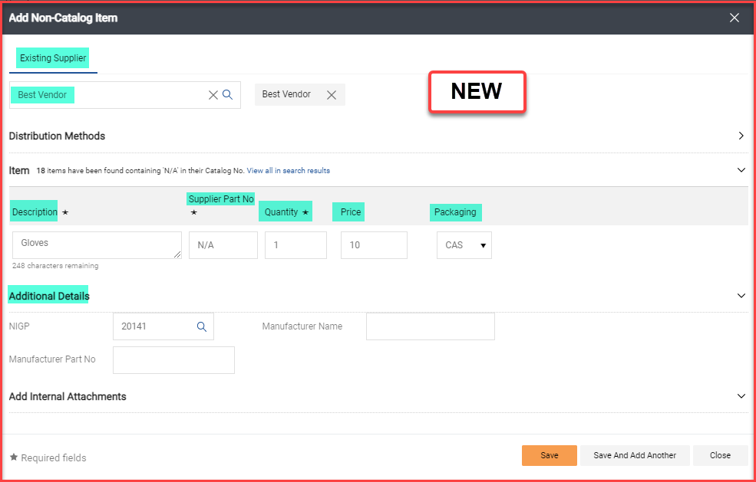
Classic Vs. New Non-Catalog item

Slide 11
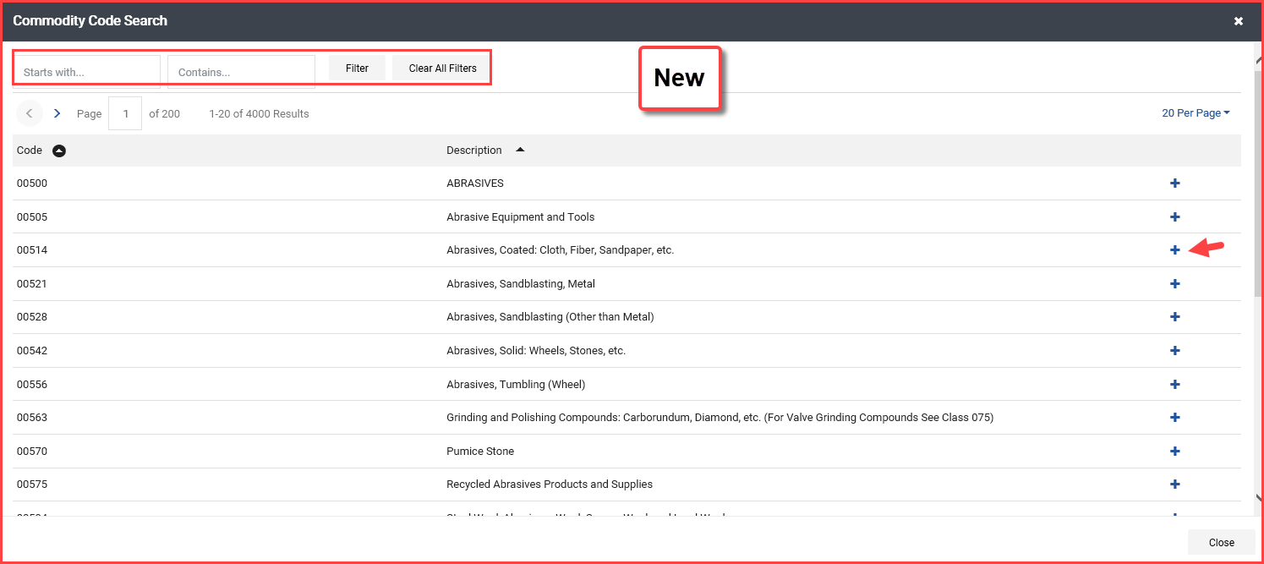
Classic Vs. New NIGP Code search

Slide 12
Classic Vs. New Shopping Cart

Slide 13
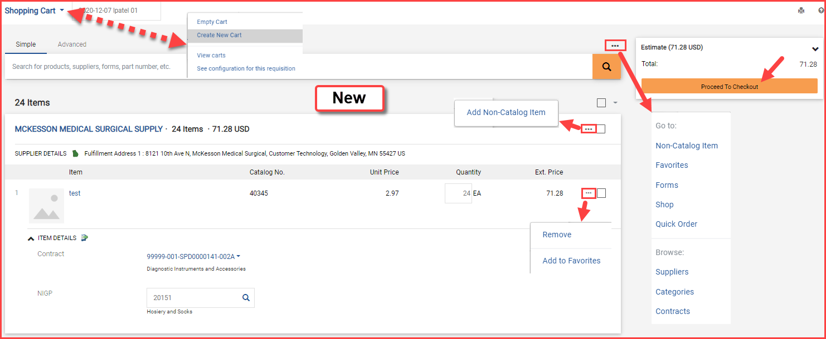
Classic Vs. New Shopping Cart

Slide 14
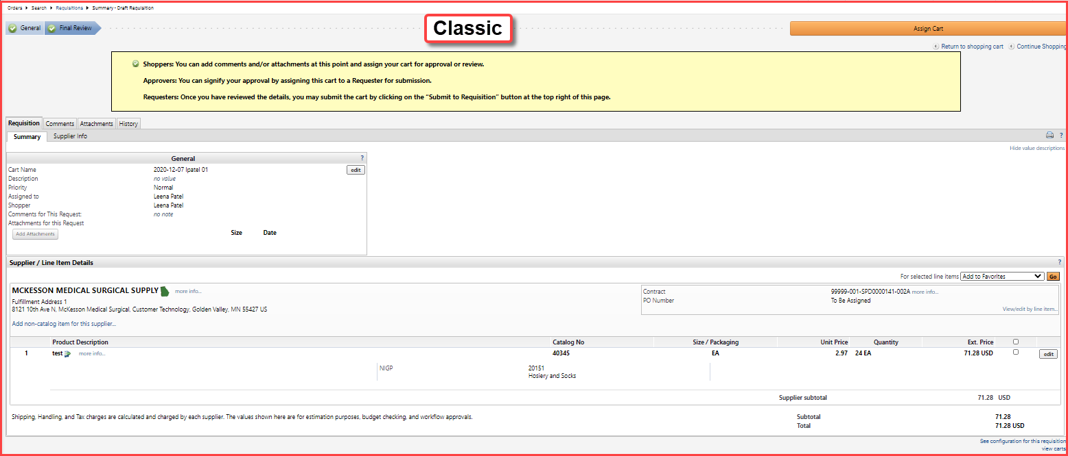
Classic Vs. New Shopping Cart

Slide 15
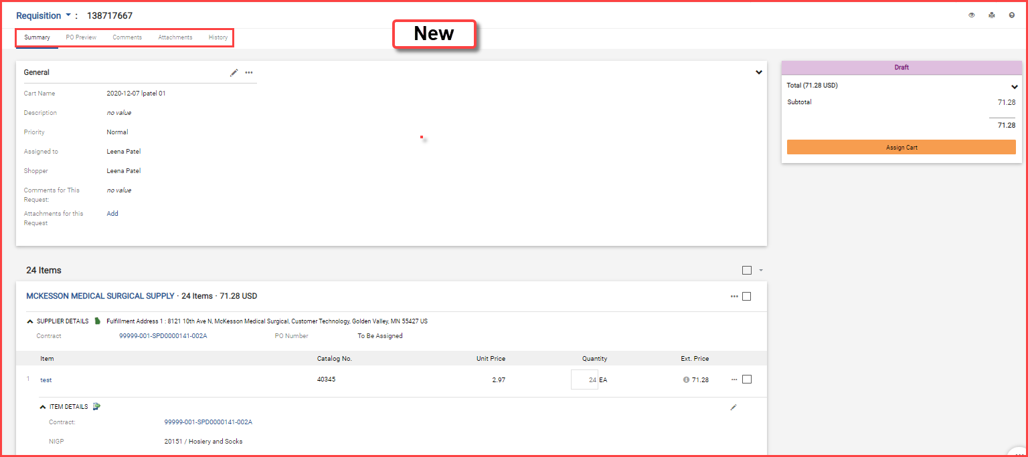
Classic Vs. New Shopping Cart

Slide 16
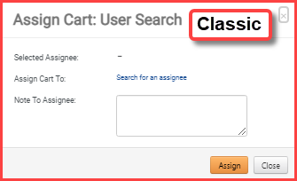
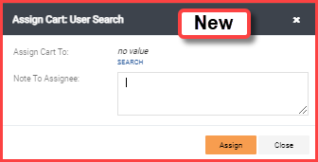
Classic Vs. New Assign Cart

Slide 17
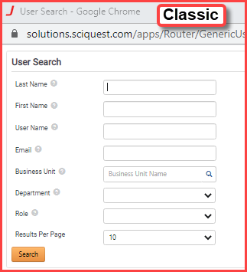
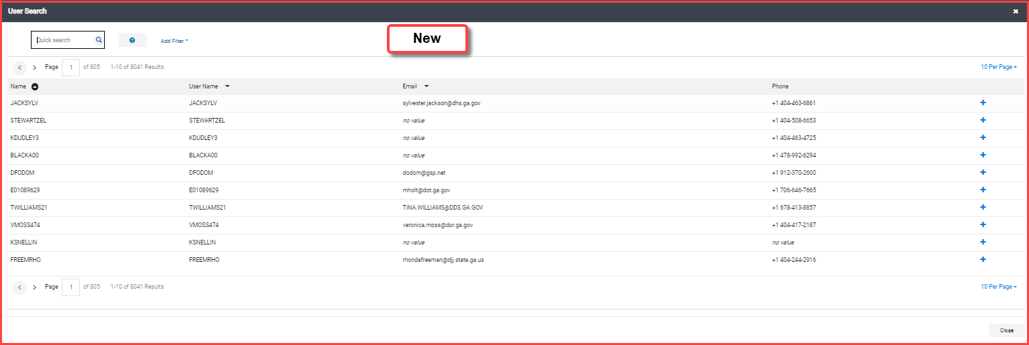
Classic Vs. New User Search to Assign Cart

Slide 18
Classic Vs. New User Search to Assign Cart

Slide 19
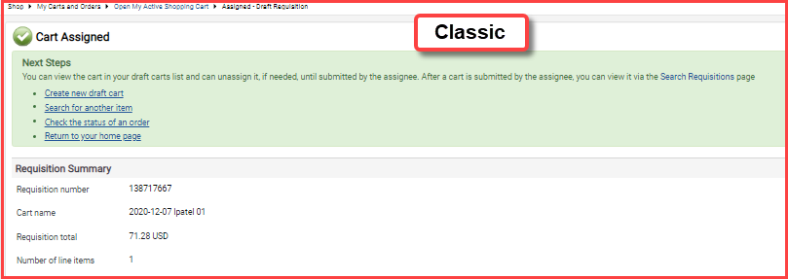
Classic Vs. New Cart Assigned Confirmation

Slide 20
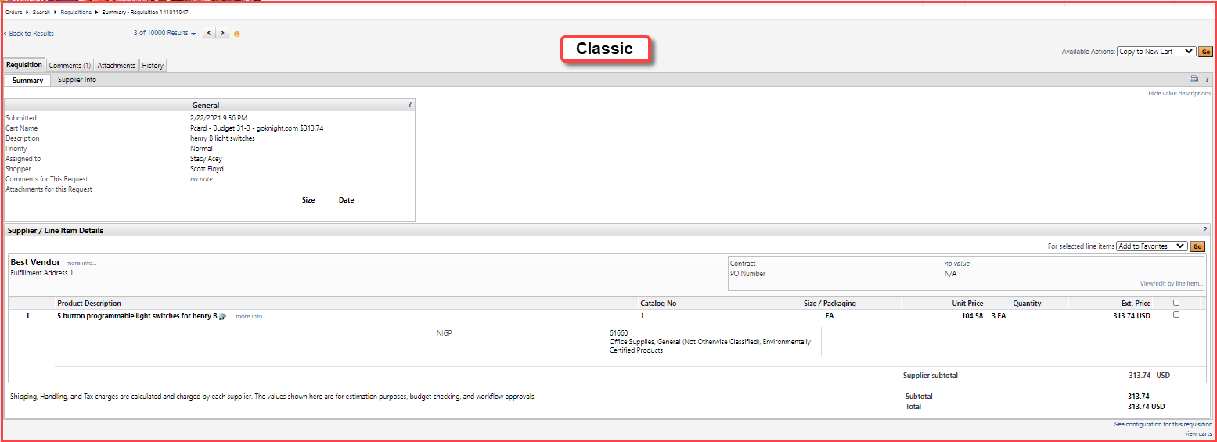
Classic Vs. New Requisition Page

Slide 21
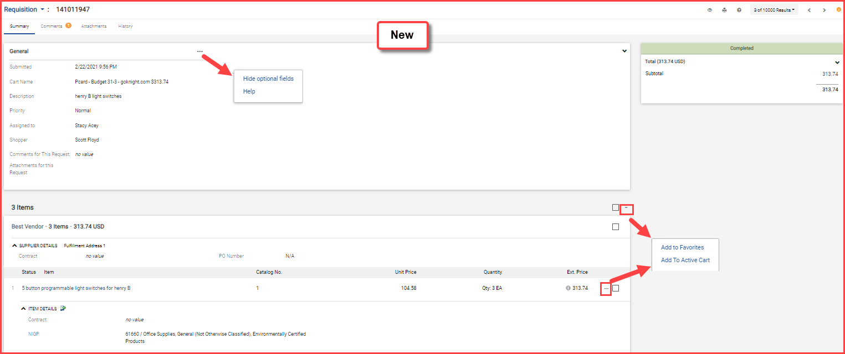
Classic Vs. New Requisition Page

Slide 22
Classic Vs. New Purchase Order Page

Slide 23
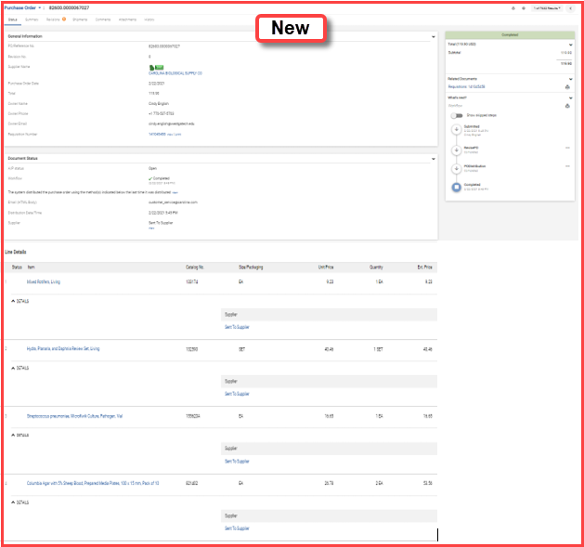
Classic Vs. New Purchase Order Page

Slide 24
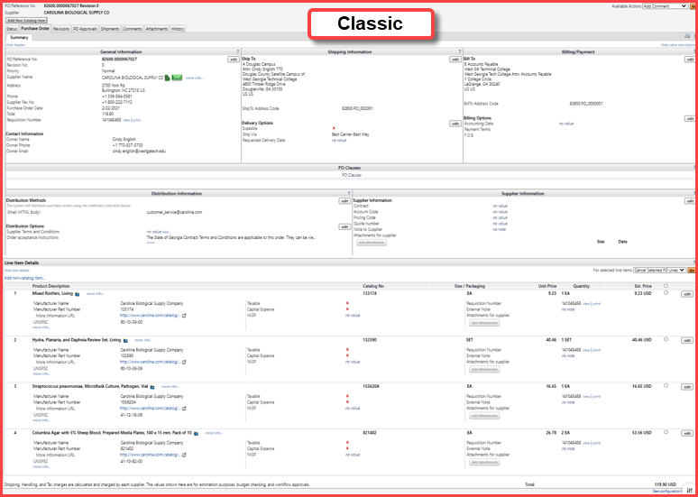
Classic Vs. New Purchase Order Page

Slide 25
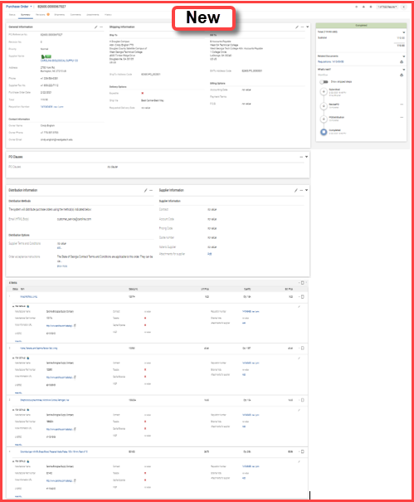
Classic Vs. New Purchase Order Page

Slide 26
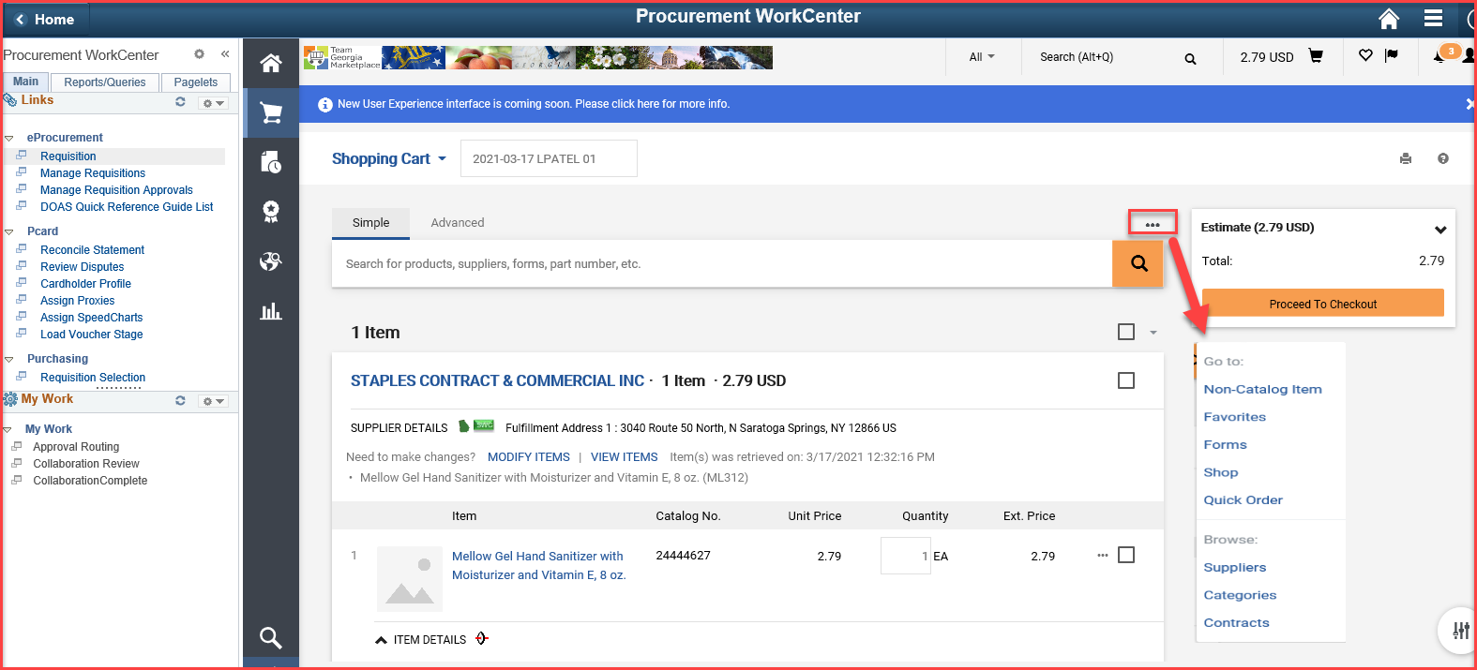
New – Create Cart as Requestor

Slide 27
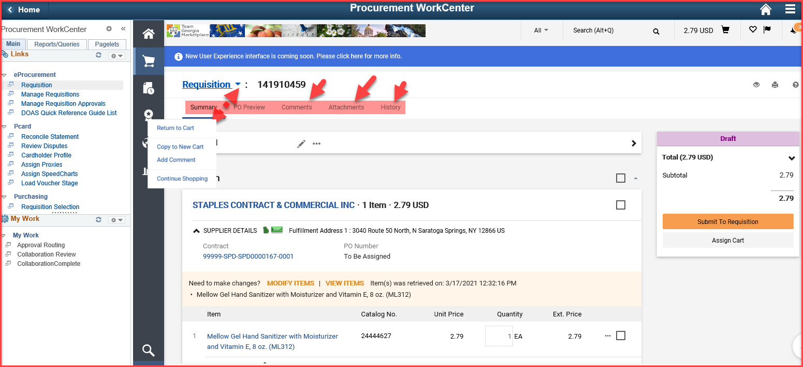
New – Submit Cart to Req page

Slide 28
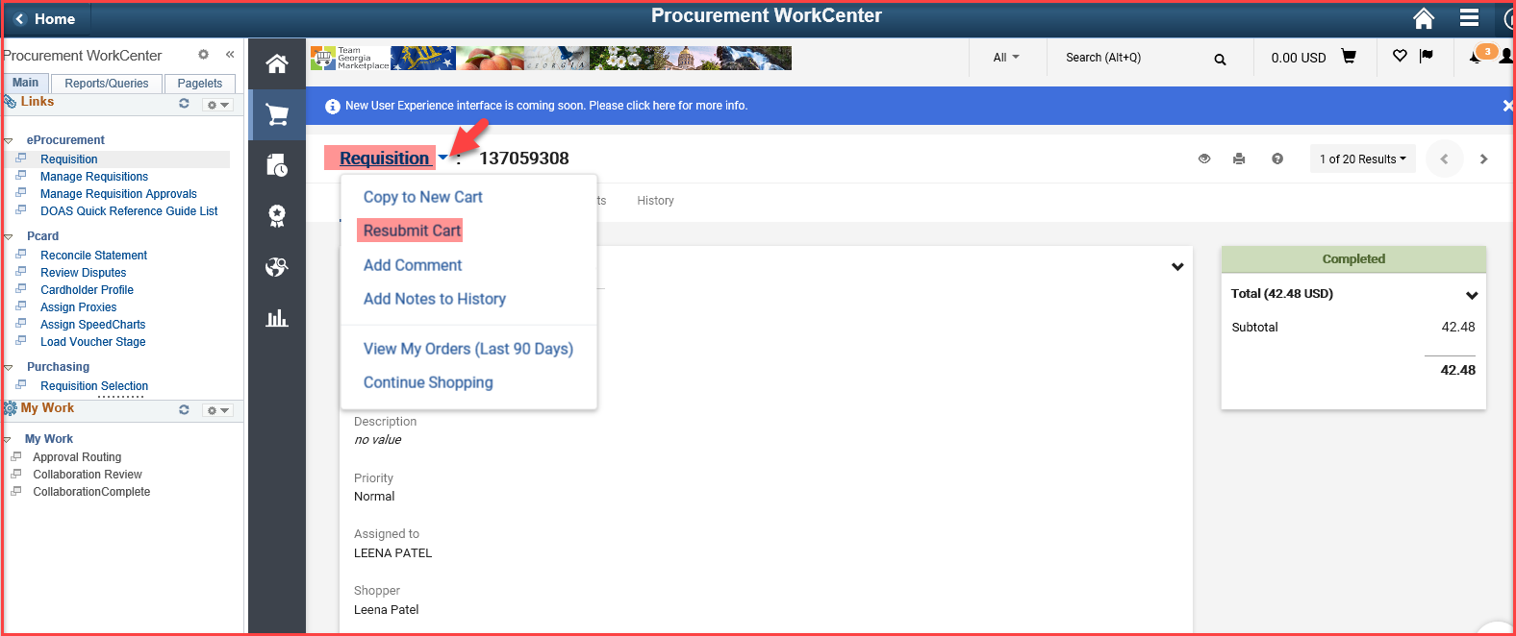
New – Resubmit Cart to Req page

Slide 29
Jaggaer Search Functionality
Team Georgia Marketplace

Slide 30
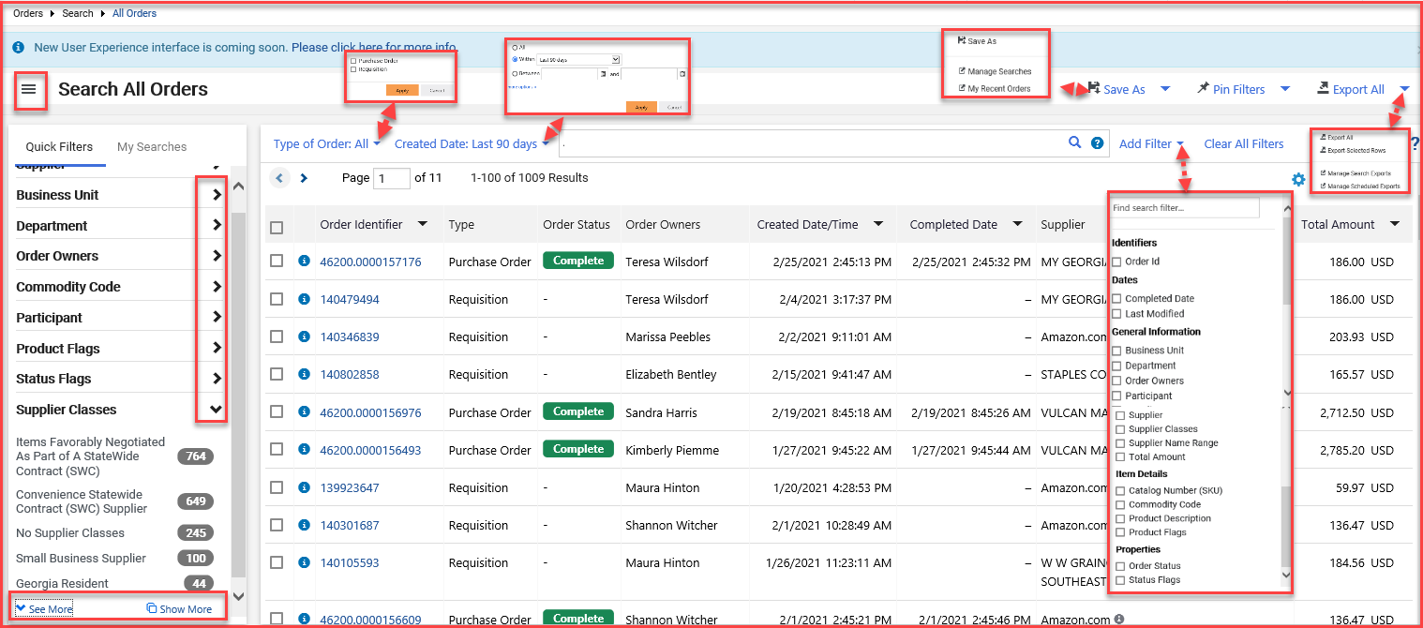
New – Search Functionality

Slide 31
New – Search Purchase Order

Slide 32
Google Chrome and Microsoft Edge – You are not authorized error
Team Georgia Marketplace

Slide 33
Google Chrome and Microsoft Edge – You are not authorized error
An issue has been identified when accessing the Georgia Virtual Catalogs system using the Google Chrome and Microsoft Edge browsers. Some users are receiving an error message when attempting to return their carts. The message states that “You are not authorized to access this component”. This message is being received due to a recent change in the browser configuration.
A resolution has been identified. The detailed resolution steps for Google Chrome and Microsoft Edge should be followed to resolve the issue.

